Slide 1
Forensic Scanner Identification Using Machine Learning
Guided by,
Dr. S. PUNITHA., M.Sc., M.Phil., Ph.D.,
Assistant Professor
Department of Computer Science
Presented By,
K. SUBASHINI

Slide 2
CONTENTS
Abstract
Introduction
Literature Survey
Existing system
Proposed system
Software Requirement
Hardware Requirements

Slide 3
ABSTRACT
Digital image authentication, source identification and tamper detection are important for forensic image analysis.
The proposed system uses deep-learning to automatically learn the intrinsic features from various scanned images.
Our experimental results show that high accuracy can be achieved for source scanner identification.
The proposed system can also generate a reliability map that indicates the manipulated regions in an scanned image

Slide 4
INTRODUCTION
With powerful image editing tools such as photoshop and GIMP being easily accessible, image manipulation has become very easy.
Hence, developing forensic tools to determine the origin or verify the authenticity of a digital image is important.
These tools provide an indication as to whether an image is modified and the region where the modification has occurred.
A number of methods have been developed for digital image forensics.

Slide 5
EXISTING SYSTEM
Due to the increasing availability and functionality of image editing tools, many forensic techniques such as digital image authentication, source identification and tamper detection are important for forensic image analysis.
Disadvantages:
Low accuracy compared to proposed system

Slide 6
Proposed System
Proposed system:
The proposed system uses deep-learning to automatically learn the intrinsic features from various scanned images.
Advantages:
High accuracy
Low cost
Less time taking

Slide 7
Modules
Load dataset:
Load data set using pandas read_csv() method.
Split data set:
Split the data set to two types. One is train data test and another one is test data set.
Train data set:
Train data set will train our data set using fit method.
Test data set:
Test data set will test the data set using algorithm.
Predict data set:
Predict() method will predict the results.

Slide 8
Software Requirements Specifications
Hardware requirement
Memory - 8GB RAM
Intel I5 Core Processor
Hard Disk : 250 Gb
Software requirement
Operating System: windows, linux
Python 11.4

Slide 9
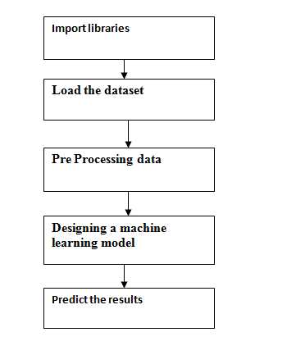
PROPOSED MODEL DIAGRAM

Slide 10
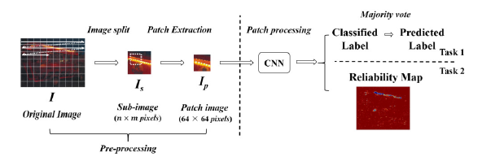
PROPOSED MODEL DIAGRAM

Slide 11
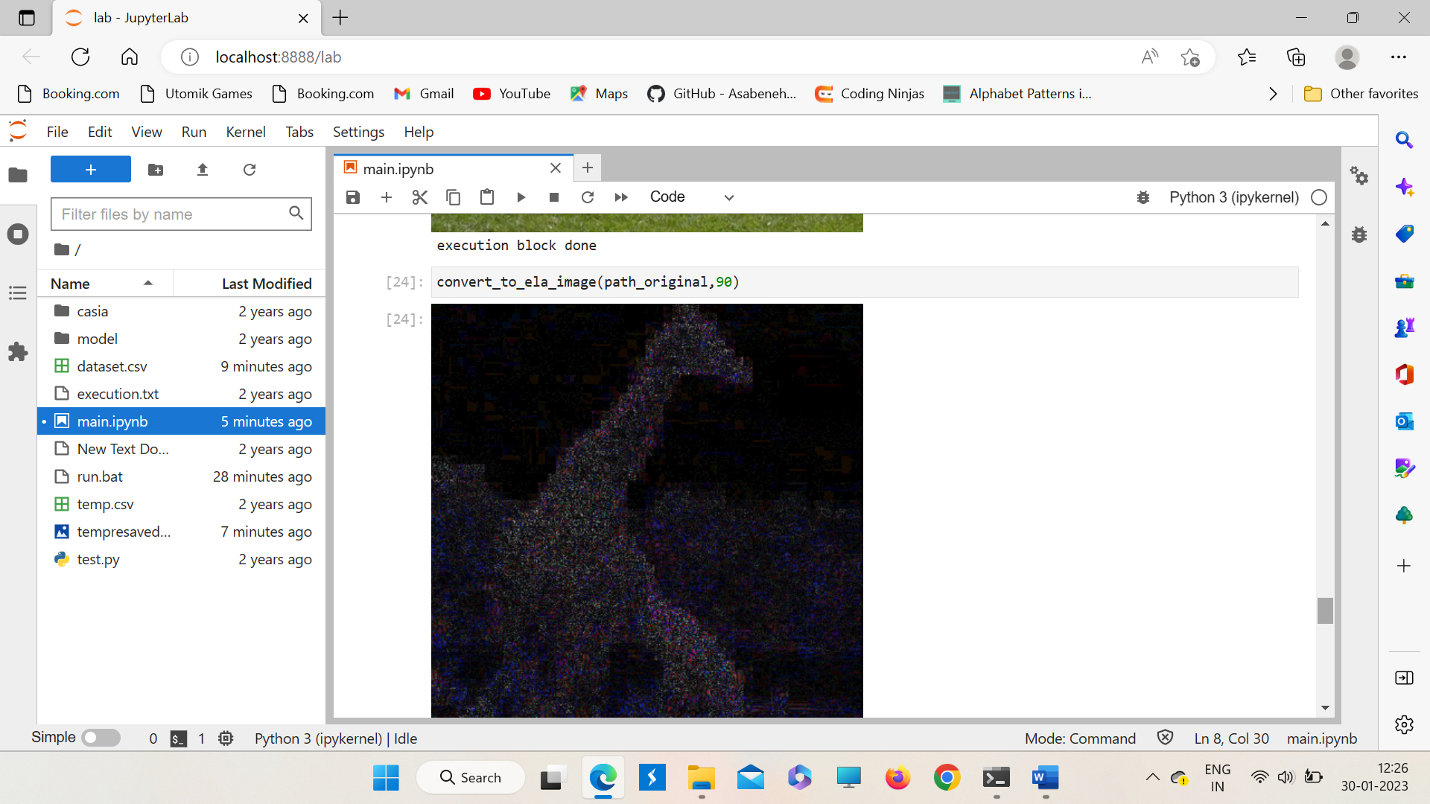
OUTPUT SCREENS

Slide 12
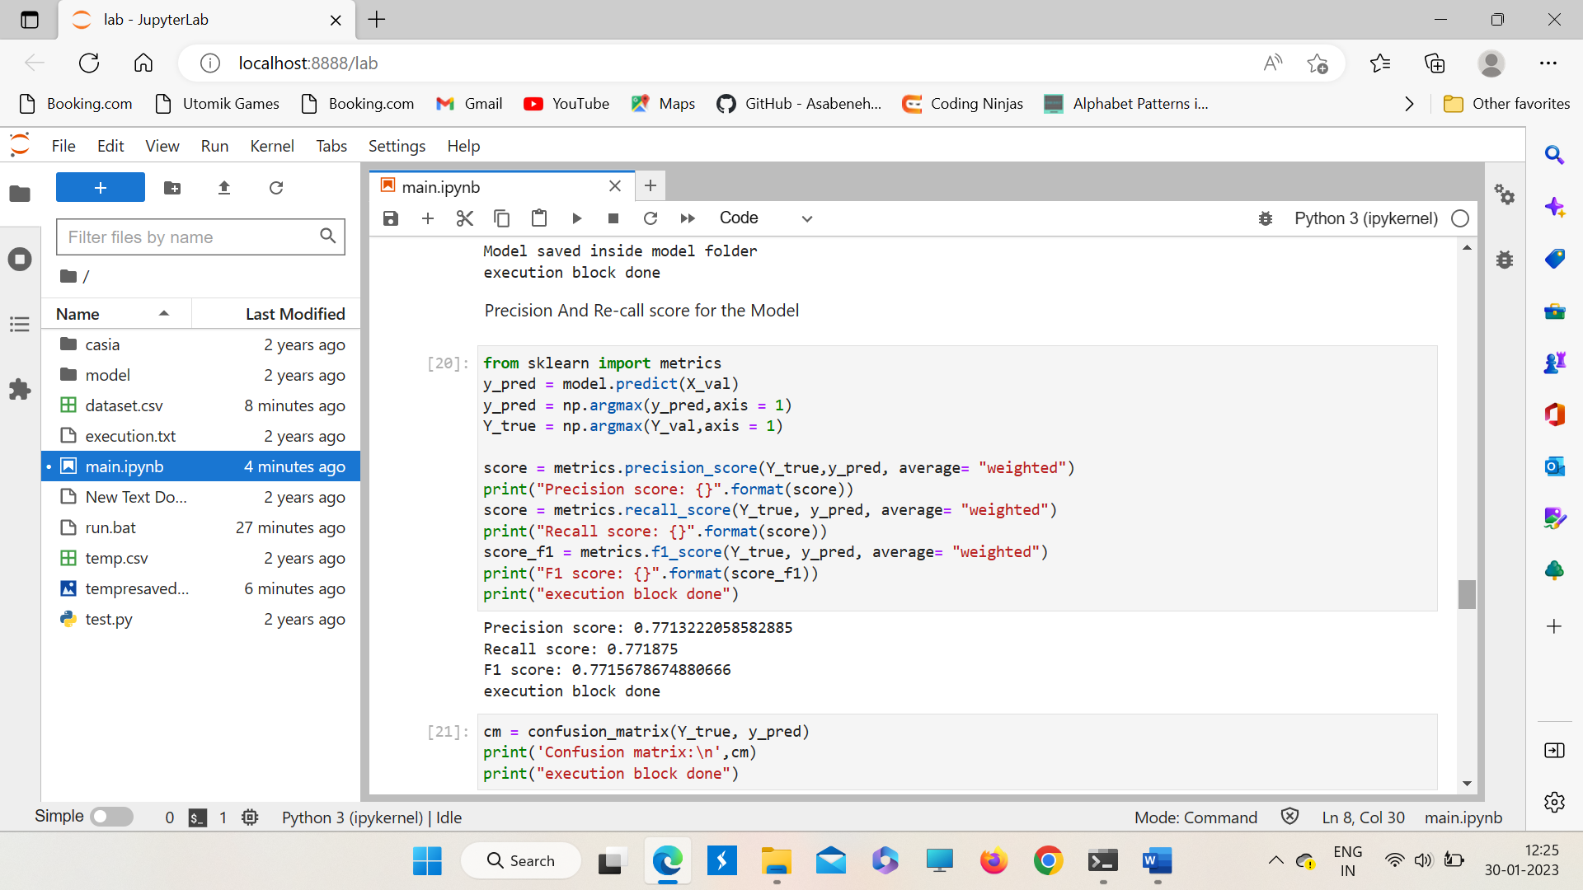
OUTPUT SCREENS

Slide 13
CONCLUSION
In this paper we investigate the use of deep-learning methods to address scanner model classification and localization.
These experimental results indicate that our reliability map provides a way to detect forgeries in scanned images.
Further work will be devoted to: a) improve the neural network architecture in the proposed system, b) detect other types of forgeries using the proposed system and c) evaluate the performance of the proposed system on scanned documents

Slide 14
REFERENCES
Python crash course.
Head-first python, 2nd edition.
Invent your own computer games with python, 4th edition.
Think python: how to think like a computer scientist, 2nd edition.
Effective computation in physics: field guide to research with python.
Learn python 3 the hard way.
Real python course, part 1.

Slide 15
Thank you

